Slide 1
The TRICS Good Practice Guide Revised
Ian Coles, Operations Manager, TRICS Consortium Limited
Notes:
In this presentation we are going to look at the 2016 TRICS Good Practice Guide, which has just been revised and will be included in the next update of the TRICS system, version 7.3.2, which is due for release at the end of July.

Slide 2
The TRICS Good Practice Guide 2016
Update of 2013 publication.
Essential document for TRICS users and auditors of TRICS data.
New section on data supply & TRICS survey compliance.
Notes:
The new edition of the guidance supersedes the 2013 edition. This guidance is an essential document for all those concerned about the proper use of TRICS. It is essential reading for both organisations that produce TRICS outputs to use in Transport Assessments, and those tasked with auditing such documents. It has been in circulation for a number of years now, and is quoted up to Public Inquiry level, where it has often been an important factor in granting (or denying) planning permission. The current version of the document is available within the TRICS Library, as the 2016 version will be in TRICS 7.3.2.
A number of tweaks and additions have taken place for the new edition, with the main addition being a new section on data supply and TRICS survey compliance, which we will discuss after a recap of the guidance in general.

Slide 3
Good Practice Guide – A Recap
Using the most up to date version of TRICS.
Understanding Land Use definitions.
Site selection by region and data fields.
The use of comment boxes.
Understanding Trip Rate Calculation Parameter definitions.
Notes:
So let’s go through a recap of the Good Practice Guide, summarising the various sections contained within the document. The guidance is broken down into 20 sections, and this and the next few slides will briefly cover each of them.
The first section covers using the most up to date version of TRICS, which at the moment of course is 7.3.1. There are generally 4 updates of TRICS each year, with there being 7.3.1, 3.2, 3.3 and 3.4 in 2016. Users can use older versions of TRICS if necessary, and the system does have a software archive allowing this, all covered in the guidance.
Then we have a section of land use definitions, making sure that users understand how each of the 110 land use sub-categories in TRICS are defined. This is followed by a section on the use of comment boxes, something there is plenty of within individual TRICS site records, and the understanding of trip rate calculation parameter definitions.

Slide 4
Understanding Trip Rate Calculation Parameter Definitions
Notes:
Here is a screenshot of part of the Help module of the TRICS system. We are looking at the definitions sub-section, and in particular trip rate calculation parameter definitions. It is important to us that our users fully understand the definitions of each trip rate calculation parameter, such as GFA, Site Area, Employees, Dwellings, and so on. The Help section provides these definitions in detail.
It is also important for users to understand trip rate calculation factors, which are displayed on all trip rate calculation results screens. For example, for Retail trip rate calculations, these are mostly displayed per 100m2 of Gross Floor Area. Calculations by Dwellings are shown per 1 Dwelling, and so on. Understanding the context of the trip rates shown in the results table greatly assists user understanding of how the calculations are made, and it is also important that trip rates, when presented in a report, are done so with these factors taken into account.

Slide 5
Good Practice Guide – A Recap
Using older TRICS data.
Seasonal trip rate variation.
Peak hours and days.
Avoiding the production of pre-determined “preferred” trip rates.
Representative sample sizes and cross-testing.
Notes:
The Good Practice Guide then looks at using older TRICS data in calculations. Although there is no fixed rule about using data outside of the standard 8-year “cut off” displayed as default during the Primary Filtering stage of the trip rate calculation process, users should make a judgement as to the cut off date to be used and the size of their subsequent survey sample. It’s all about getting a decent balance.
Seasonal trip rate variation is covered next, as of course some sites will produce variation of trip generation throughout the year, and there is a section of peak hours and days (covered more in the next slide).
An important section of the document is how to avoid the production of “pre-determined” trip rates, or trying to achieve trip rates to fit your own targets. This is not a good approach to trip generation analysis, and there are steps in place to encourage users not to go down this path, but instead to analyse the database objectively without any pre-perceived trip rates in mind. This is something that we have been working hard on over a number of years now.
Then we have a section on representative sample sizes and the “cross-test” feature which compares mean and median trip rate values.

Slide 6
Peak Hours & Days
Notes:
So looking at the peak hours and days section, the guidance tells us that is best practice to provide trip rate calculation results covering peak periods, both road peaks and the dataset’s own calculated peaks (supplying the full calculation results output covers all of this).
A new feature of this edition of the guidance is a comparative survey trip rate graph, which we can see in this slide. This is a feature of TRICS that was introduced in TRICS 7, a very handy feature that displays vehicular trip rates for each of the selected surveys in a dataset. Looking at the graph, we have hours of the day along the x-axis, and vehicular trip rate up the y-axis. This is an excellent visual example of how trip rates vary within datasets in TRICS, and a reminder to users that TRICS does not intend to provide an exact “prediction” for a development scenario. Instead it provides users with a range of values with best and worst case scenarios which users should work with.

Slide 7
Good Practice Guide – A Recap
Re-surveys and multiple surveys.
Weighting factors in trip rate calculations.
Trip rates and limits of extrapolation.
Mixed Use sites and TRICS.
Understanding count type definitions.
Notes:
The next section of the guidance is re-surveys and multiple surveys. TRICS does a lot of the work here by automatically excluding older surveys when they have been re-surveyed at a later date at the same development, and this is to avoid over-representation at any particular development, ensuring that only one survey at each unique development is included in the final dataset of surveys for calculation.
This leads onto “weighting” factors. We are of course dealing with average trip rates in multi-survey calculations, and this section goes into detail about how such factors should be dealt with by users. This is followed by a section on trip rates and limits of extrapolation (see the next slide), followed by a section on mixed use sites in the database.
Then there is a section on understanding count type definitions. Again, the Help module has a number of definitions sub-sections, and one of these explains the various count types such as total vehicles, vehicle occupants, public transport use4rs, and so on. Users should ensure that they fully understand how these count types are defined to avoid any confusion or misrepresentation when writing reports.

Slide 8
Trip Rates & Limits of Extrapolation
Notes:
Let’s have a brief look at trip rates and limits of extrapolation. In this slide we can see a typical trip rate calculation results screen, with the “estimate” feature being used to extrapolate trip rate results into an additional column. You can see highlighted the estimate calculation factor plus the extrapolated trip rates columns.
Much care should be exercised when extrapolating trip rates, as there are varying degrees of accuracy when extrapolating by different land uses, and indeed by different trip rate calculation parameters within land uses. The reliability of extrapolation can be visually assessed through the production and analysis of trip rate scatterplot graphs, which we can see on the next slide.

Slide 9
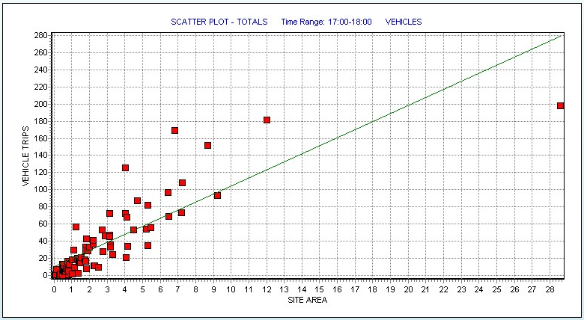
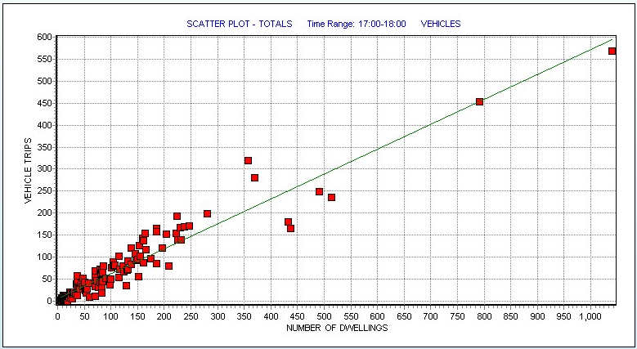
Trip rates for Residential developments (03/A – Houses Privately Owned)
Higher error margin (Site Area)
Lower error margin (Dwellings)
Notes:
Here is a good visual example of a comparison between residential trip rates when calculated firstly by site area and then secondly by number of dwellings. In this example the land use category 03/A (Houses Privately Owned) has been used. In each case, vehicle trips is shown on the y-axis. The scatterplot on the left shows site area on its x-axis, and on the right the parameter used is number of dwellings.
We can clearly see that the scatterpoints are closer to the line of best fit for number of dwellings than for site area. This is because the left (site area) graph does not take into account the varying density of developments within the selected dataset, resulting in the greater error margin displayed.
Users should make a judgement in each case as to the reliability of extrapolating trip rate results by carefully examining the corresponding scatterplots. The amount of scatter variation will of course vary by land use type as well as trip rate calculation parameter type, and there will always be external factors influencing trip rates for individual sites within any dataset, hence the need for caution.

Slide 10
Good Practice Guide – A Recap
Correct presentation of trip rates and methods.
The Standardised Assessment Methodology (SAM).
TRICS-Compliant Surveys and the provision of survey data.
Notes:
The final few sections of the new edition of the Good Practice Guide are shown here. There is a section on the correct presentation of trip rates and methods, which of course is very important. It is vital that users of TRICS present their results in details so that these results can be audited and scrutinised fully. This is followed by a section on the Standardised Assessment Methodology (SAM) for surveys at sites with Travel Plans in place, and then we get to the new section on TRICS-Compliant Surveys and the provision of survey data, which we cover in the next slide.

Slide 11
The Process of Ad-Hoc TRICS Data Commission
Initial contact with the TRICS team.
Authorisation for site visit and production of survey specification (£500 + VAT fixed fee).
Supply of all-inclusive quote to client.
Survey undertaken
Data input and validation process.
Finalised TRICS outputs sent to client.
Notes:
And here is this next section broken down into two parts. Firstly we have the ad-hoc commission of multi-modal surveys by client organisations. We undertake a number of these each year, whereby a client first makes contact with the TRICS team and requests a site visit and a survey specification. The process for this is as follows. There is a £500 + VAT fixed fee for undertaking this work, which, upon authorisation from the client, is then included in the all-inclusive quote that is supplied once the survey specification has been produced. At that point, should the client not want TRICS to go ahead with the survey, the fixed fee would be charged. If the client did want TRICS to go ahead with the survey, then nothing would be payable until the survey had been completed, the data input and put through validation testing, and the finalised TRICS outputs forwarded to the client.
This is the standard procedure for ad-hoc commissioned surveys. These have been undertaken since multi-modal surveys first commenced for TRICS in the early 2000’s.

Slide 12
Timescales & TRICS Survey Windows
Best practice to allow 6 weeks from first communication to the survey date.
Spring survey window: March-mid July.
Autumn survey window: September-November.
Allow another 6 weeks following survey date for data processing, input and validation.
Notes:
Something to bear in mind though is, for good practice to be properly adhered to in the commissioning of ad-hoc surveys, there are realistic timescales involved. It is best practice (and it is practical) to allow around 6 weeks from the first communication with the TRICS team to a survey taking place. Our data collection companies need lead time to ensure that staff can be hired and that the survey can be properly planned.
There are two survey windows, the first from March to mid-July, and the second from September to November. Organisations wishing to commission ad-hoc surveys should not leave it until the last minute before the windows close to request surveys, or they may very well be disappointed. Nevertheless, at TRICS we always get a last minute rush towards the end of each window. We do our best to deal with it, but we do ask that reasonable timescales are taken into account.
Organisations should also expect the process from the survey date to the finalised TRICS outputs being forwarded to be a period of around 6 weeks. Of course, these timescales can vary on a site by site basis, but this is a good general guide based on our experience in dealing with these surveys.

Slide 13
Data Provision and TRICS-Compliance
Organisations can undertake their own TRICS surveys.
TRICS Multi-Modal Methodology should be followed.
Data should be supplied in full in standard TRICS format.
Compliance subject to successfully data validation testing.
Certificate of TRICS-Compliance issued post-validation.
Notes:
Now we move on to TRICS-Compliant Surveys. It is of course possible for organisations to undertake their own TRICS surveys, if they use our established multi-modal methodology and supply the data in full to us on our standard TRICS data collection forms. Organisations can have their surveys certified as “TRICS-Compliant”, but for this the proper procedure must be followed.
Our Multi-Modal Methodology document is available freely upon request. This document explains the procedures for undertaking site visits and producing survey specifications to the TRICS standard. Also, our data collection forms are also freely available. When a survey has been completed, it should be forwarded to the TRICS team for input and validation testing. This is a rigorous process, and only when data is fully validated can a survey be called TRICS-Compliant. A certificate of compliance is then forwarded to the client organisation.

Slide 14
TRICS-Compliant Surveys: Input & Validation Testing Costs
Level 1 Survey Day (traffic count): £100 + VAT
Level 2 Survey Day (multi-modal count): £150 + VAT
Level 3 Survey Day (multi-modal count with Travel Plan information): £200 + VAT
Notes:
There are costs for the validation process, which are shown here. A traffic survey (which we call a Level 1 count) is charged at £100 + VAT. A multi-modal (Level 2) survey costs £150 + VAT, and a Level 3 survey (a multi-modal survey plus travel plan information) is charged at £200 + VAT.
If anyone wants to discuss the validation process, or TRICS-Compliance of surveys in general, they should contact a member of the TRICS team.

Slide 15
Benefits of TRICS-Compliance
“Having a survey registered as TRICS-Compliant means that the data has been thoroughly tested by an independent organisation and is considered to be of a high standard of robustness, following a widely recognised methodology.”
“TRICS considers survey data that has been registered as TRICS-Compliant as being of recognisable high quality.”
Notes:
There are a couple of quotes from the TRICS Good Practice Guide that we can end with. The first is as follows. “Having a survey registered as TRICS-Compliant means that the data has been thoroughly tested by an independent organisation and is considered to be of a high standard of robustness, following a widely recognised methodology.” And the second is as follows. “TRICS considers survey data that has been registered as TRICS-Compliant as being of recognisable high quality”. So you can see that it makes sense to undertake your own multi-modal surveys to the TRICS standard and have them certified as so.

