Slide 1
TRICS SAM Surveys – Case Studies from a Survey Company’s Perspective
Marie Hancock

Slide 2
Outline
What’s different from our perspective
Staff Briefing – Wealden District Council
The survey day …

Slide 3
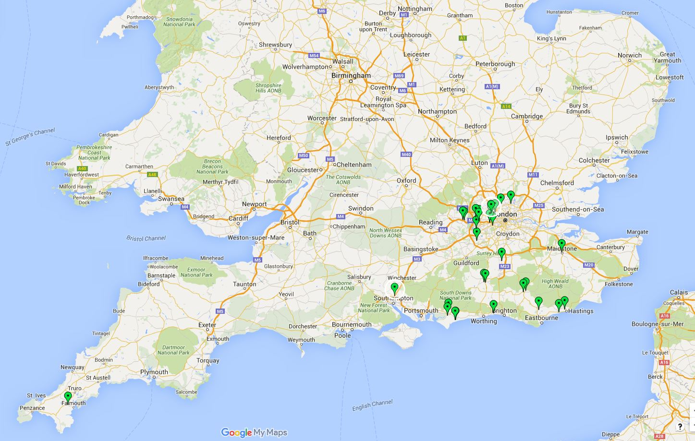
SAM so far …
Land Uses: mainly housing, but also
Hospitals, Offices, Car Sales, Mosque, Warehousing and distribution,
Supermarket, University Campus, Mixed Use ...
(For us) focus on London and South-East (with one exception)

Slide 4
What’s different ?
Surveys include other information
Travel Plan Assessment
Journey Purpose
Origin / Destination
Repeat surveys every few years

Slide 5
The SAM Process
Receive a request to tender from TRICS
Provide winning bid!
Site visit, contact site manager
Mobilise and brief staff
Carry out survey
Analyse and validate data

Slide 6
Staff briefing
Video

Slide 7
The survey day

Slide 8
The survey day
05:15 - Alarm goes off. Get up, have a coffee. Pick up survey bag with sunhat, sun cream, thermos, MHTC yellow jacket, ID badge, pencil, rubber, sharpener. Ready to go.

Slide 9
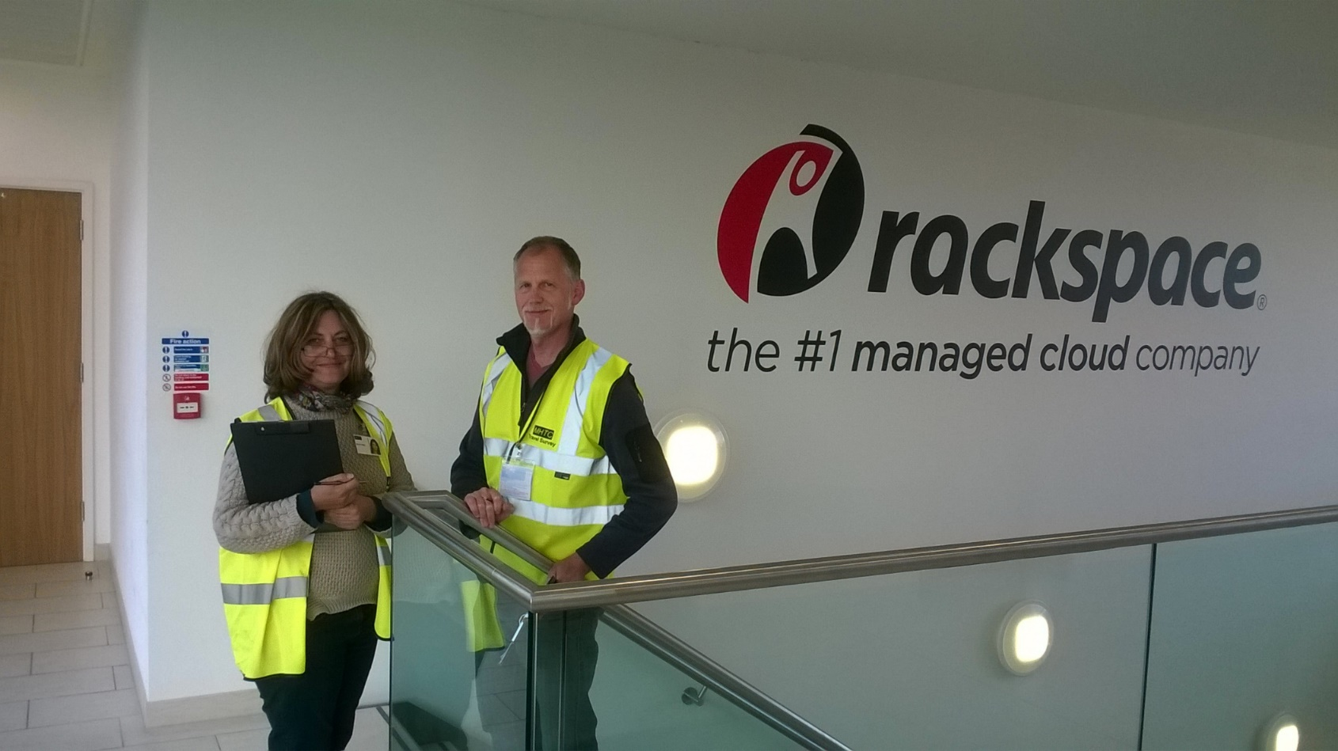
The survey day
07:15 - Survey is underway. Everyone was on-time. Just waiting for the office workers to arrive now.

Slide 10
The survey day
09:30 - My first break. We work on a rota with two to three hours’ working and 30-60 minutes break.

Slide 11
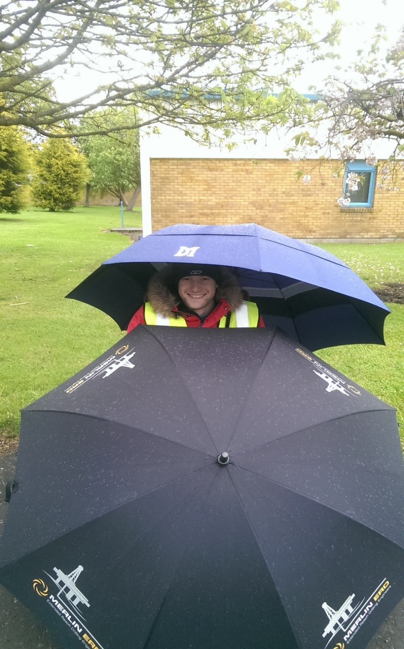
The survey day
11:30 – Rain …
but it doesn’t stop play (or work).

Slide 12
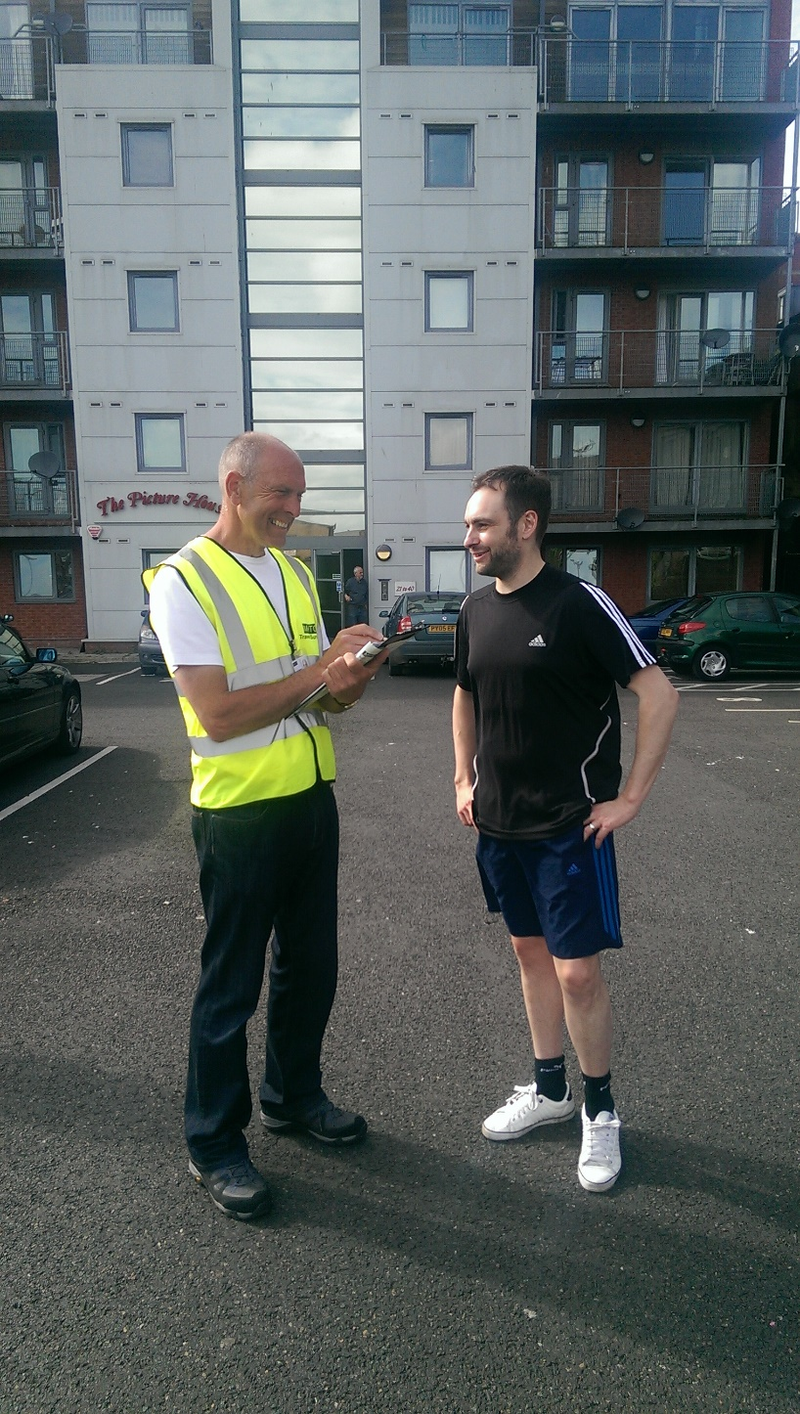
The survey day
13:30 – Sunny again.
Everything going nicely …

Slide 13
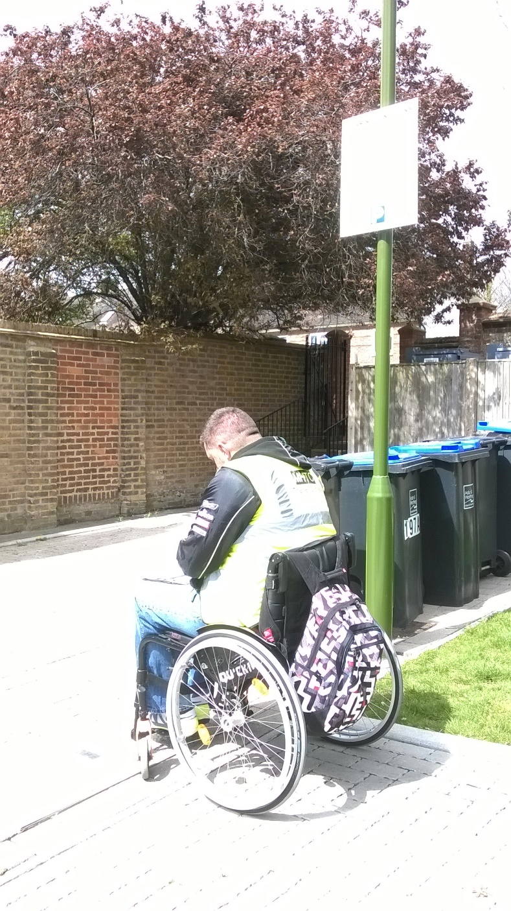
The survey day
14:30 – Still sunny …

Slide 14
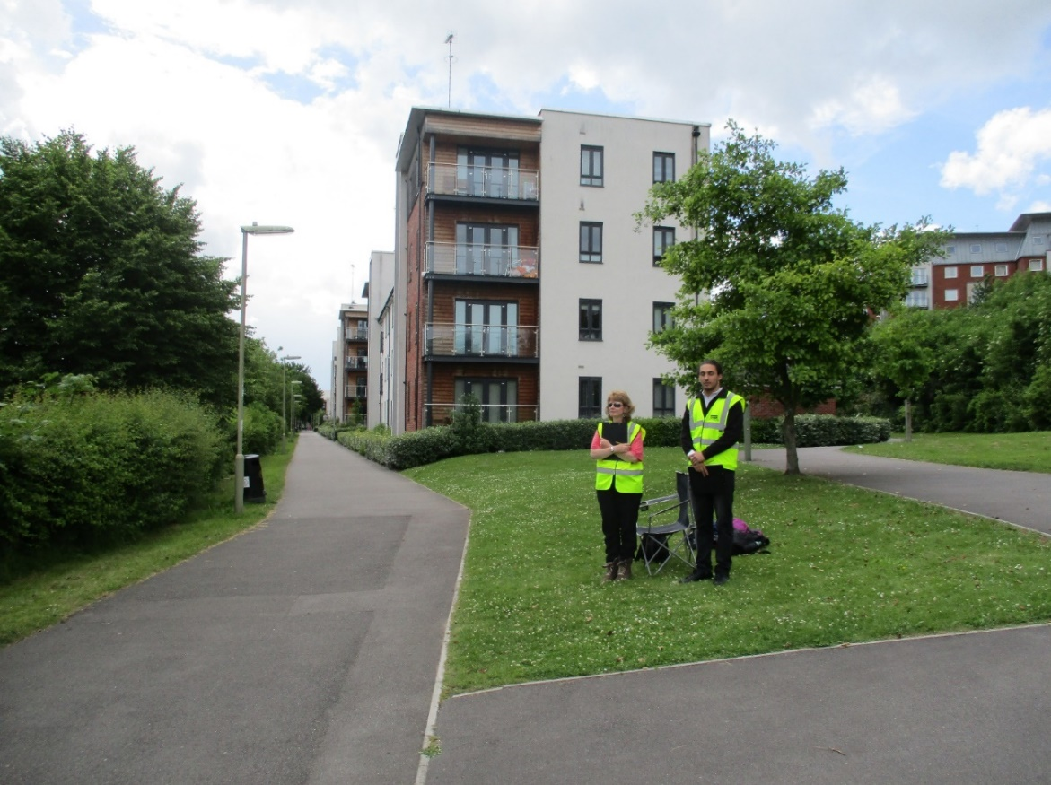
The survey day
15:30 - The calm before the storm.
Notes:
We are now waiting for the army of school children returning, before the onslaught from mum and dad coming back from work. It may look like we are overstaffed, but you just wait …

Slide 15
The survey day
16:35 – Just had news of an unexploded bomb in the building site down the road !!! Lots of police cars and fire engines. I guess that’s the end of surveying for today. Probably not typical behaviour.

Slide 16
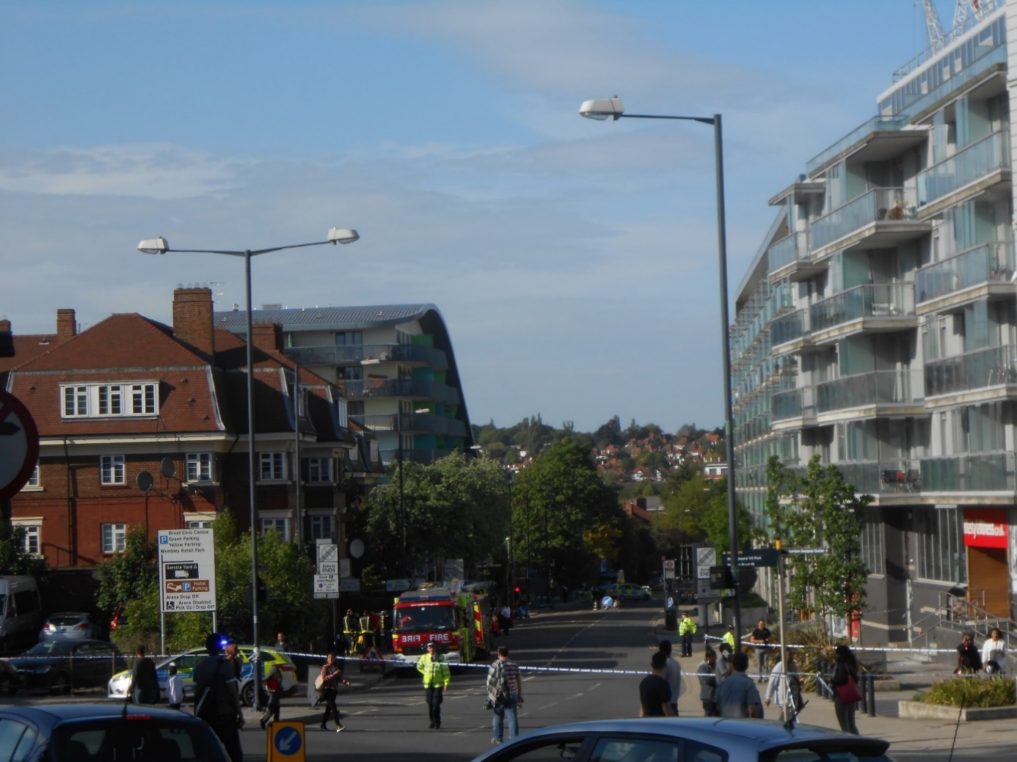
The survey day
16:52 – Bombs do stop play. Survey abandoned !

